Slide 1
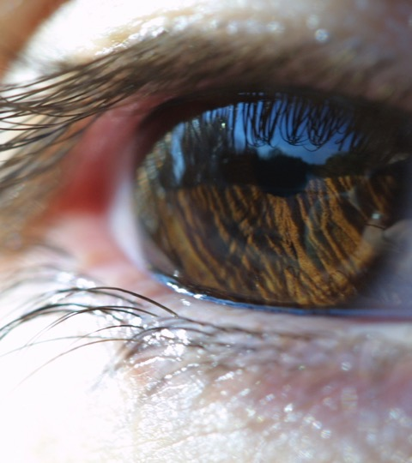
CHANGING LIVES BY SAVING SIGHT

Slide 2
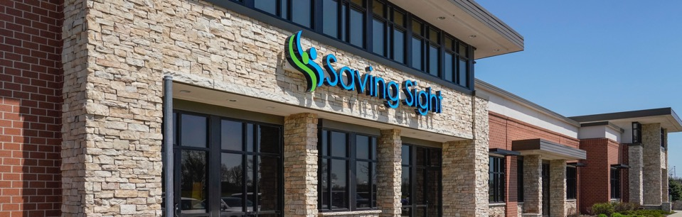
OUR MISSION & VISION
Our Mission | We change lives by Saving Sight.
Our Vision | To be the global partnership model for how eye banking and charitable vision services can most effectively serve people and communities.

Slide 3

BOARD OF DIRECTORS
As a 501c3 nonprofit, Saving Sight is governed by a 13-person board of directors. Per organizational by-laws, the board composition is as follows:
Serving up to two consecutive 3-year terms:
7 Lions elected from each of the 7 Lion MD26 districts
4 Non-Lion community members
Serving a one year term:
1 Lion MD26 Council of Governors’ Chair
1 Lion MD26 Council of Governors’ Vice-Chair

Slide 4
OUR HISTORY
1960 to present day
Lions’ Pledge
Columbia Office
IL Operations
Missouri Lions pledge $250,000 to help build facility in Columbia
Building is constructed in Columbia with funds raised by Lions
Eye bank operations expand into Springfield, Illinois
1967
1974
1997
1960
1972
1987
Our Beginning
Non-Profit Status
State Sight Project
Lions Eye Bank formed in partnership with University
Formalized as 501(c)3, the Eye Research Foundation of Missouri
MO Lions vote to accept eye bank as state sight project and rename it MLERF

Slide 5
OUR HISTORY
1960 to present day
Saving Sight
KidSight 501(c)3
Saving Sight
Name change to MLERF d/b//a Saving Sight
Saving Sight’s KidSight program becomes an independent non-profit
Kansas Eye Bank becomes a division of Saving Sight, serving the Wichita area
2013
2016
2021
1998
2015
2019
KS Operations
Vital Tears
Eyeglass Recycling
Eye bank operations expand into Kansas
Saving Sight enters partnership as part-owner and processor of Vital Tears
Ownership of Saving Sight’s eyeglass recycling program is transferred to MO Lions

Slide 6
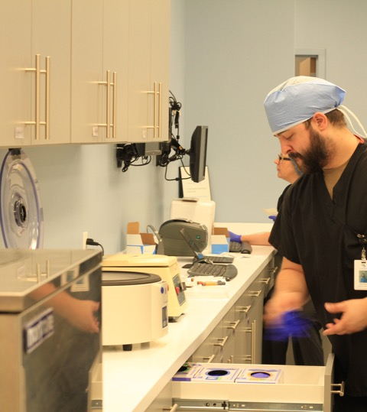
EYE BANK OPERATIONS
Follow the journey of donation to transplantation in providing the gift of sight

Slide 7
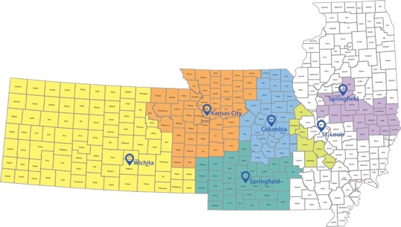
OUR SERVICE AREA
Saving Sight operates six office locations throughout MO, KS, and IL, allowing us to provide the gift of sight through donation and transplantation to those in our local communities, all over the US and abroad.

Slide 8
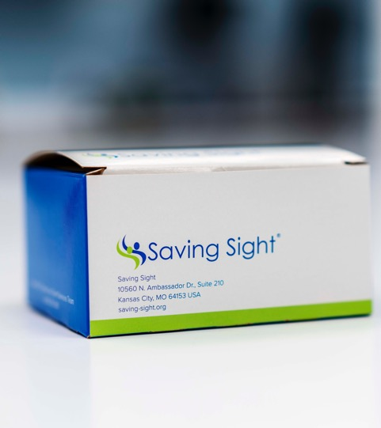
A LEADER IN SERVICE
Saving Sight is within the top 5 largest eye banks in the nation and provides the gift of sight through corneal donation to approximately 10 people each day.

Slide 9
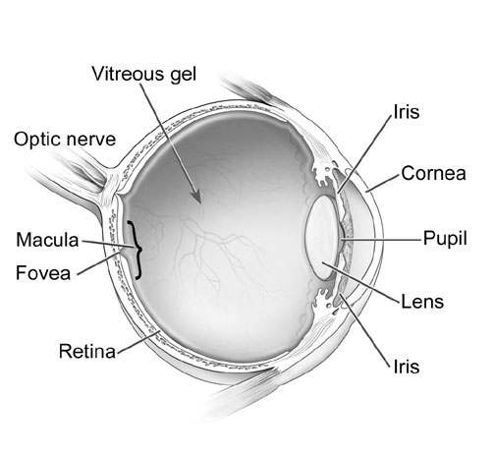
THE HUMAN EYE
The cornea, or clear outer window of the eye, is the most-commonly used tissue for sight restoring transplants and the primary tissue that we recover.

Slide 10
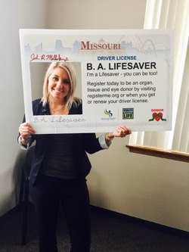
EYE DONATION PROCESS
The journey of donation to transplantation
DONOR DESIGNATION
.
When someone joins the organ and tissue donor registry either online or at the DMV, they make their wishes known to someday become a donor upon their death.
Join the organ and tissue donor registry at registerme.org

Slide 11
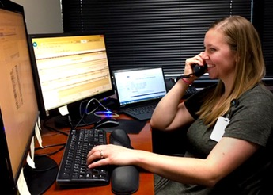
REFERRAL RECEIVED IN DSC
When a death occurs at a hospital, Saving Sight’s Donor Services Center (DSC) works with the organ procurement organization to screen for donor suitability. If we’re able to move forward with donation, DSC staff contact legal next-of-kin to offer donation opportunities as well as to contact a medical and social history screening.
Saving Sight’s DSC coordinates an average of 7 recoveries a day.

Slide 12
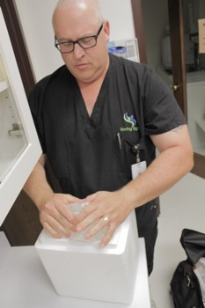
TISSUE RECOVERY
The DSC dispatches an on-call staff technician to the recovery site. This is usually the hospital morgue. The tech will assess for indications of infectious disease, take a blood sample and recover the corneal tissue. In some cases, we will also recover additional ocular tissues for research and training.
Corneal recovery must occur within 24 hours of time of death.

Slide 13
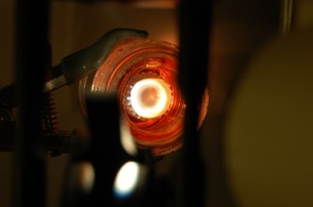
TISSUE EVALUATION
All tissue is transported to our KC office, where it is evaluated for cell count and transplant suitability. At the same time, staff continue to review that patient’s medical records to make sure there are not contraindications for transplant. We also review serological results to ensure no infectious disease is present.
A higher donor cell count generally indicates better outcomes for transplant patients

Slide 14
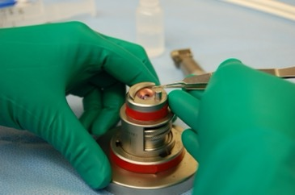
TISSUE PROCESSING
Specialists in our KC lab location prepare the tissue to the physician’s specification and type of surgery that occur. About half of the tissue that Saving Sight prepares is for a partial thickness corneal transplant and needs to be carefully cut with surgical equipment at our lab prior to delivery to the physician.
Our lab team will make cuts of tissue that is just 10-15 microns thick (about this thickness of household plastic wrap)

Slide 15
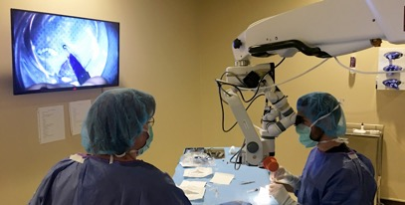
DISTRIBUTION & TRANSPLANT
Our Client Services team matches up requests from physicians to the tissue we have available and arranges for delivery of tissue for the patient’s transplant surgery. We prioritize fulfilling requests for our local physicians in MO, KS and IL first, then others throughout the US and finally those internationally.
Tissue is typically transplanted between 4-7 days after the donor’s time of death.

Slide 16
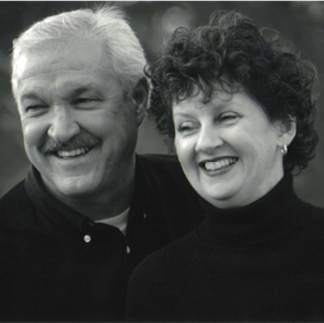
THE IMPACT OF DONATION
When Theresa McClellan suddenly lost her husband Rick during a volleyball game in 2014, her whole world changed. “He’s just a great guy gone way too soon,” said Theresa. Because living an active lifestyle was so important to Rick, he and his wife had talked about organ donation and end-of-life-care.
It was impactful for her that Rick was able to help people until the very end with his gift of life. Since Rick’s passing, Theresa has become an avid supporter of the healing power of donation as a volunteer and ambassador for Saving Sight.
“It just helps me as I transition to life without him – it helps me know that I honored a wish of his,” said Theresa.

Slide 17
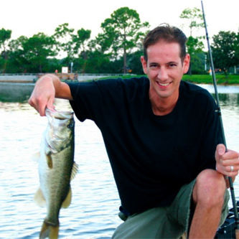
THE IMPACT OF DONATION
In his early 20s, Chris was diagnosed with keratoconus, a disorder that causes the cornea to become distorted. Keratoconus affected his job in I.T., limited his ability to drive, and worst of all, affected his passion for fly fishing.
Today, thanks to the gift of sight from his eye donors, the talent of Dr. Tauber, and the support of Chris’ optometrist, Chris is back on the water and enjoying his favorite sport.
"The first time I was able to fly fish after my surgery was amazing," said Chris. "There was so much detail in everything I was allowed to see in the colors and the detail in the water."

Slide 18
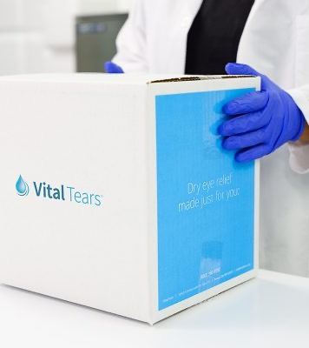
VITAL TEARS
Extending our mission of changing lives by saving sight to help more people in need

Slide 19
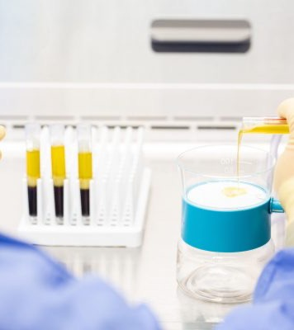
ABOUT VITAL TEARS
Vital Tears are a type of autologous serum eye drops (ASED) made from a patient’s own blood. Saving Sight is a partner in the company, Vital Tears, and processes all of the eye drops for patients, nationwide. This is one additional way we’re able to help preserve sight for the approximately 16.4 million Americans who suffer from dry eye disease.

Slide 20
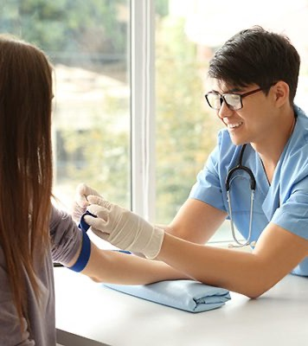
THE VITAL TEARS DIFFERENCE
Vital Tears has quickly become the leader in providing ASEDs throughout the U.S. due to its quick and hassle-free system for patients and physicians. We offer convenient options for blood draws, including in-home mobile visits, custom serum dilutions and effortless payment and delivery options.

Slide 21
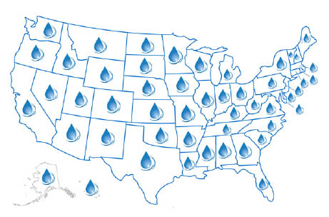
VITAL TEARS GROWTH
Today, Vital Tears is offered in every state throughout the US. A total of over 93,000 orders have been placed and processed by Saving Sight since 2015.

Slide 22
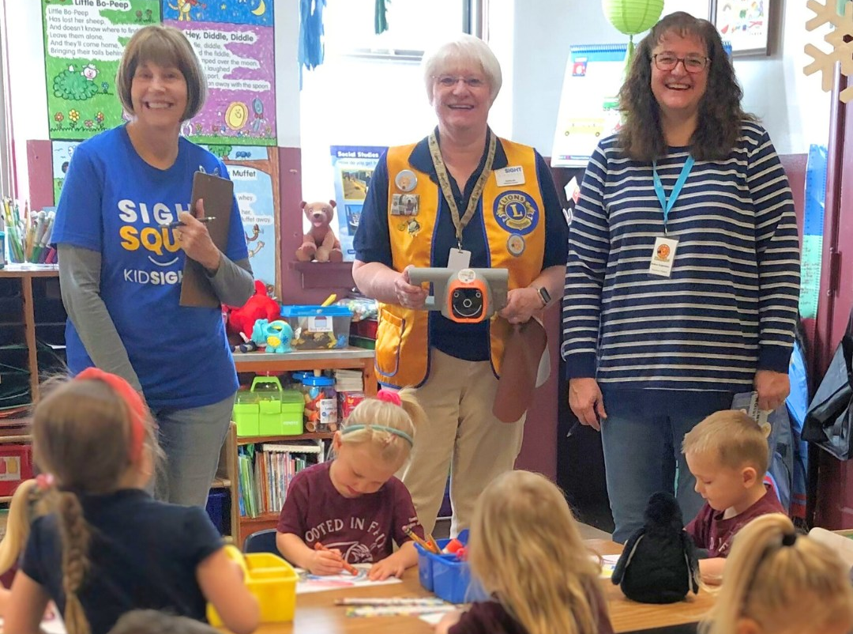
CHARITABLE SUPPORT
Through an endowment program, Saving Sight is able to support nonprofits with similar mission. In the past year alone, we gave $60,000 in grant funding to:
KidSight, for children’s vision screenings
Missouri Lions Eye Mission Foundation, for vision screening equipment for missions
Showme Lions Eyeglass Recycling, for facility upgrades
Mid-South Lions Sight and Hearing Services for direct patient care

Slide 23

GET INVOLVED
You can help us impact the lives of others!

Slide 24
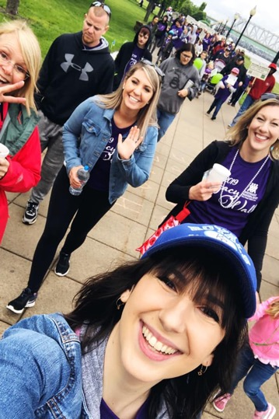
01
Donor Designation
Join the organ and tissue donor registry! Better yet, encourage your friends and community to join, as well!
02
Become an Advocate
Follow Saving Sight on social media and share the good news of the work that we’re doing to help others and why you support us.
03
Make a Financial Donation
Your financial donation ensures our continued ability to help others receive the gift of sight and educate our community about donation.
Learn more about opportunities and sign up for news at
www.saving-sight.org/lions

Slide 25
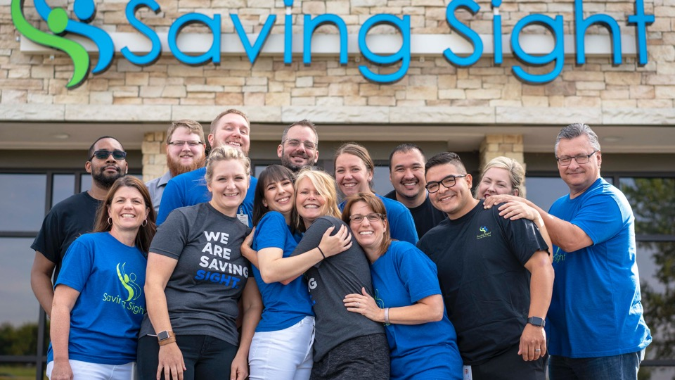
THANK YOU!
Questions?

